Slide 1
MEMORIES
RAM – SINGLE/DUAL PORT
FIFO – ASYN/SYN

Slide 2
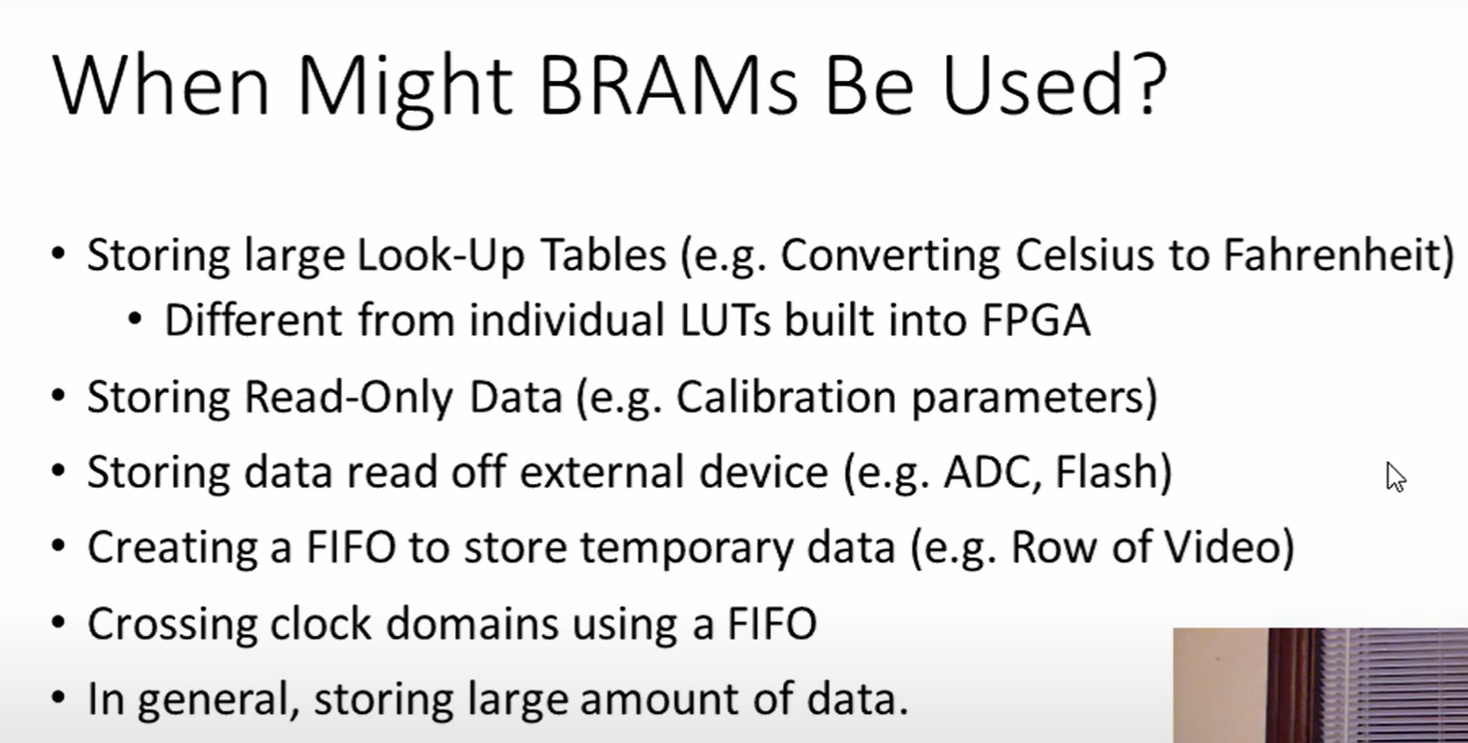

Slide 3

OVERVIEW

Slide 4

1024 – word *
32-bit
array

Slide 5








NO OF ROWS = DEPTH/ NO . OF WORDS
NO. OF COLUMNS = WIDTH/ NO. OF BITS
0 | 1 | 0
1 | 0 | 0
1 | 1 | 0
0 | 1 | 1

Slide 6
BIT CELLS
Bit cells arranged in 2-d array.
To access- activate wordline and bitline
Each bit is stored in a bit cell.
Bit cell can store – 0/1
Stored bit
Access a certain bit cell:
Bit cell could be a flip flop.
Activate bitcell

Slide 7
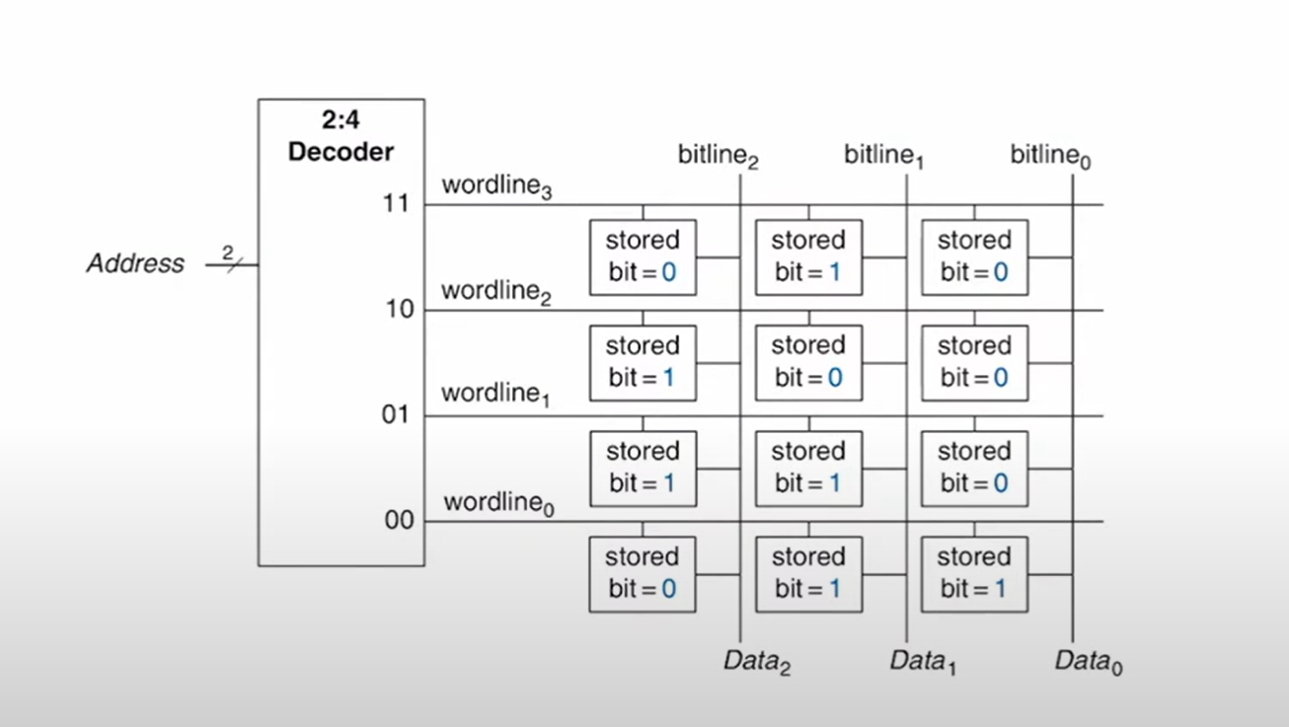



BIT CELLS ORGANIZATION

Slide 8




MEMORY PORTS

Slide 9











MEMORY TYPES

Slide 10































Slide 11
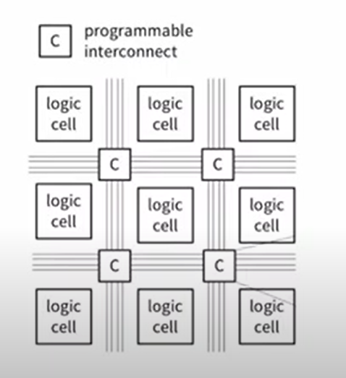





Slide 12
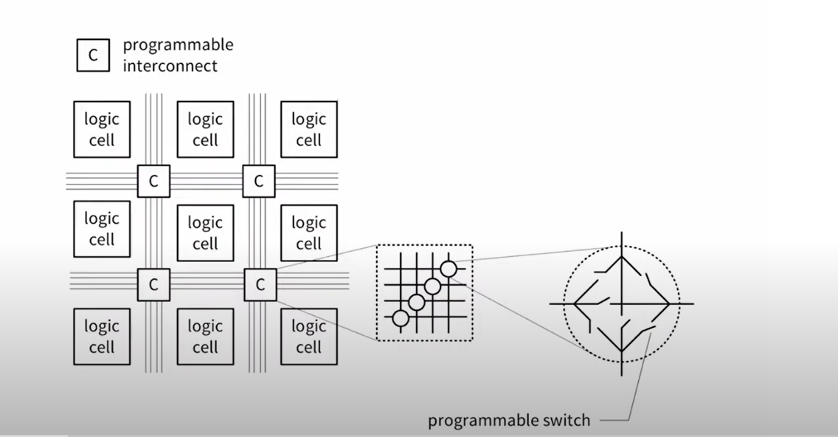









Slide 13
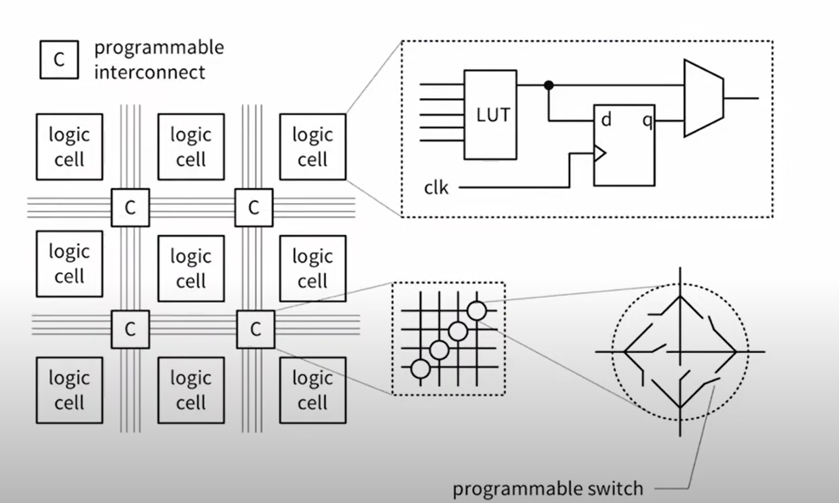








Slide 14
MARCO CELLS
Now we can program a memory using these LUT and FF but it is not a very efficient method for FPGA.
Apart from Logic cells , FPGA have ‘MARCO CELLS’ which are not shown in previous figure.
MARCO CELLS – NOT PROGRAMMABLE
They are dedicated ASIC for specific functionalities
Some marco cells are memory blocks.
They are thrown in between logic cells so that you can use them when needed.

Slide 15














XILINX NOMENCLATURE
4 Logic cells (LC) = Slice
2 Slices = Configurable Logic Block (CLB)

Slide 16
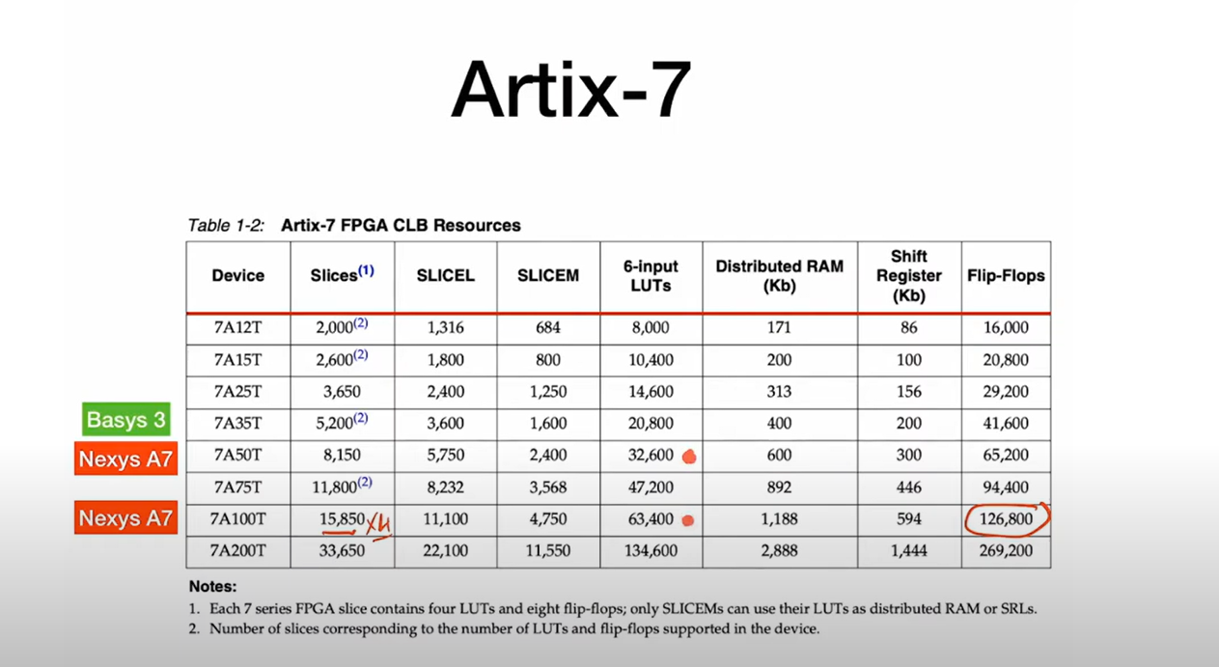










Slide 17
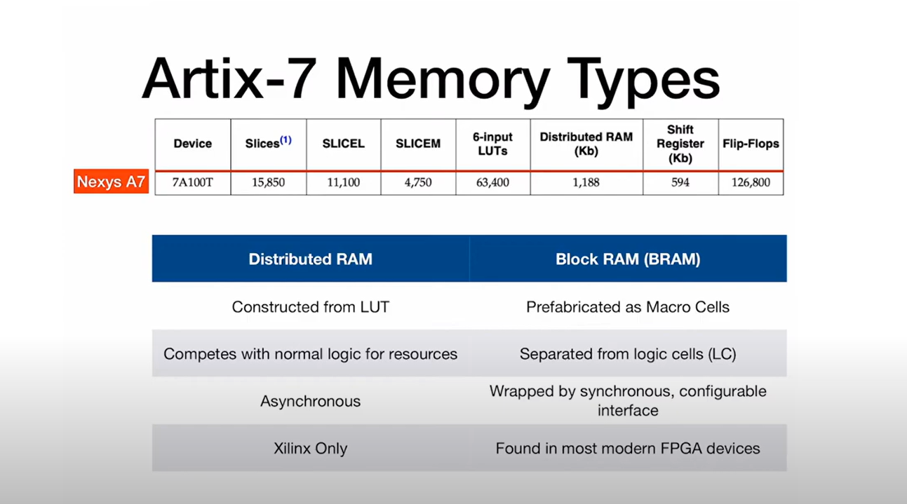






Slide 18
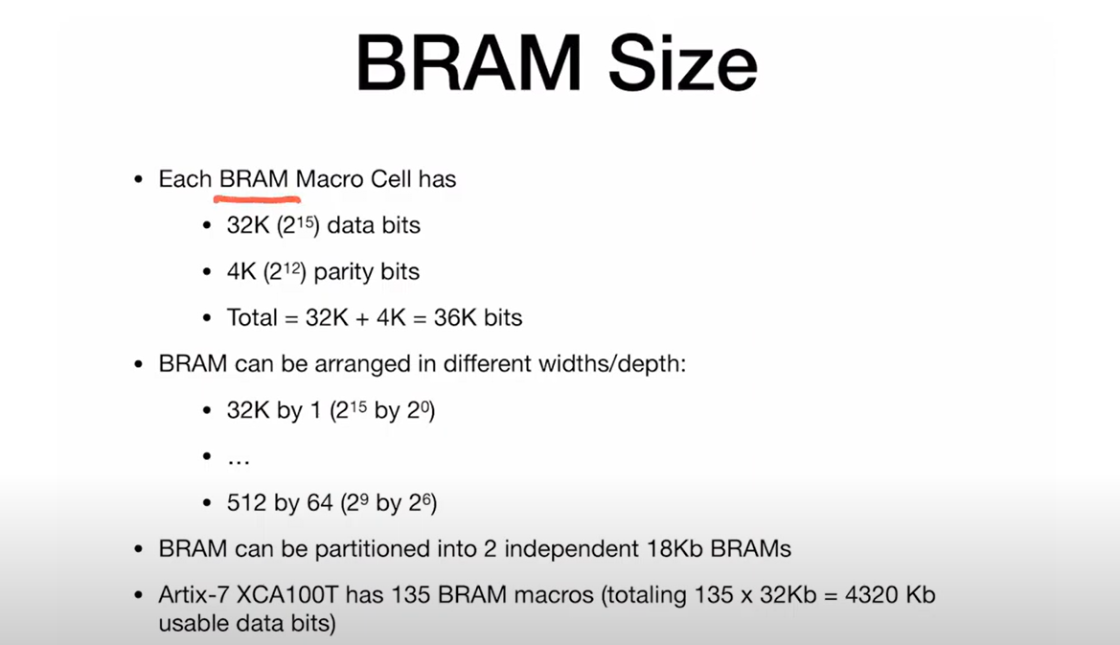

Slide 19
Multiple ways to implement memory
1. GENERAL CODE – when we are least interested in which resources we utilize for our memory.
2. LANGUAGE TEMPLATE- targeting specific memory resources
3. IP METHOD – most effective

Slide 20


KEY ASPECTS
Depth (2^ADDR_WIDTH)
Width (DATA_WIDTH)
Number of ports
Direction of a port
Synchronicity of a port
Simultaneous address access

Slide 21


SINGLE PORT RAM – GENERAL METHOD
ALLOWS US TO PERFORM READ OR WRITE OPERATION ON ANY ONE MEMORY LOCATION AT A TIME

Slide 22
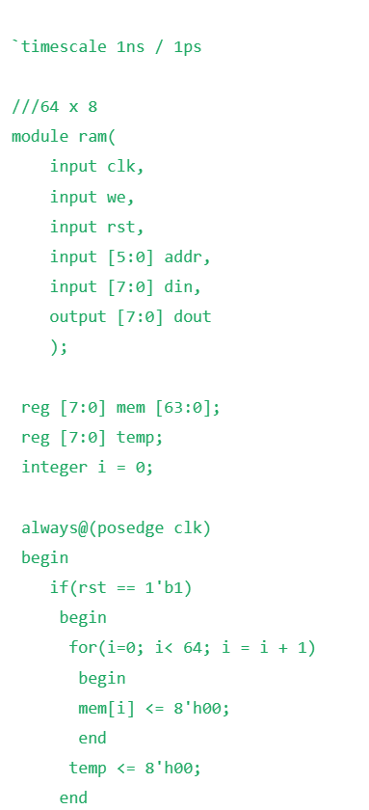
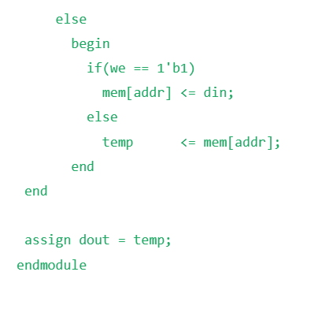
CODE

Slide 23
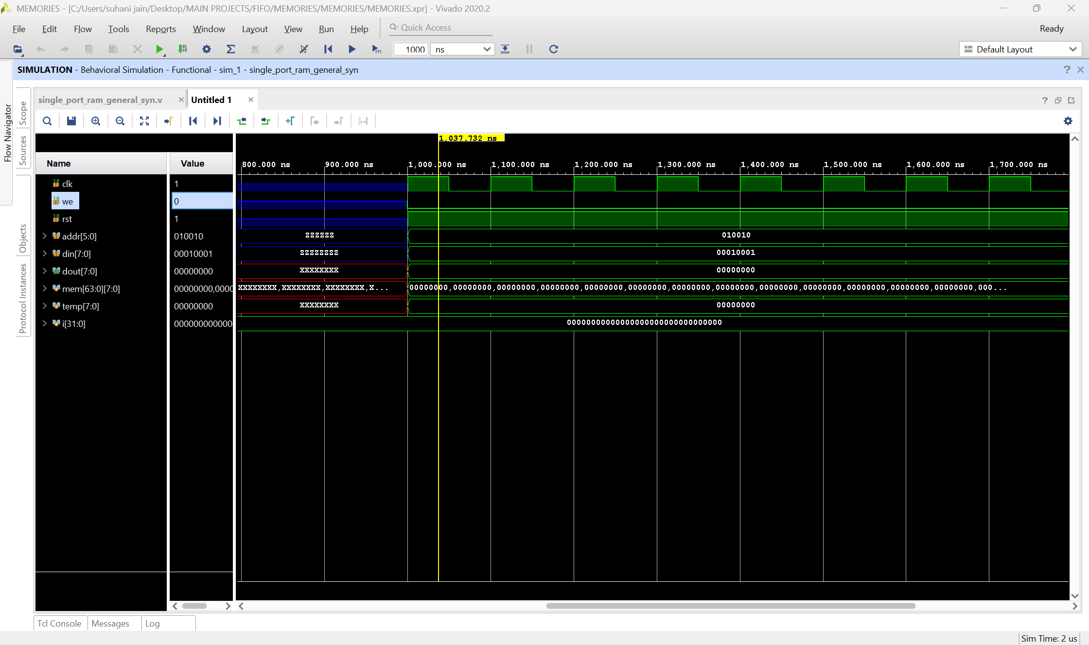
SIMULATION RESULT – when reset
Memory initialised with 0

Slide 24
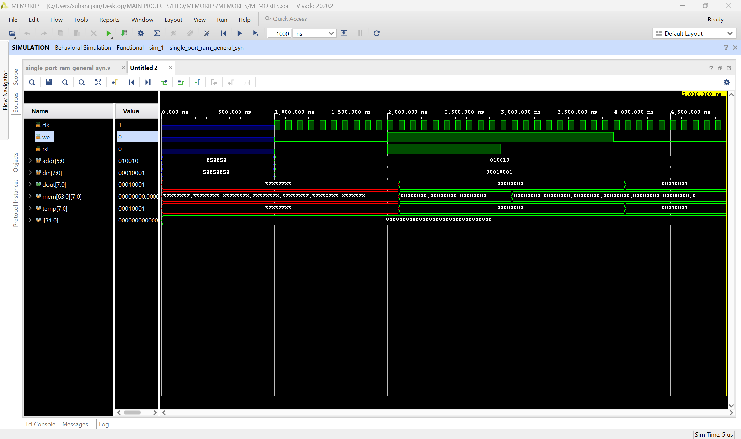

Slide 25
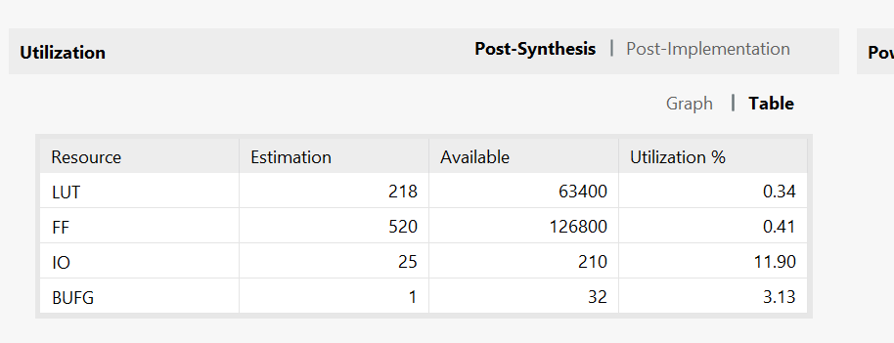
SYNTHESIS – can see use of distributed ram or logic cells

Slide 26
SINGLE PORT RAM – LANGUAGE TEMPLATE
NOTE : INFERRING A BRAM WITH LANGUAGE TEMPLATE IS WAY TOO DIFFICULT, SO WE PREFER IP METHOD, EVEN IF WE FOOLOW THE EXACT TEMPLATE
SO, BRAM -> IP METHOD
DRAM -> LANGUAGE TEMPLATE METHOD

Slide 27
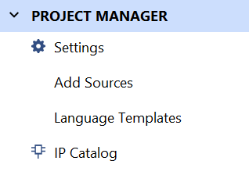
Click on language template

Slide 28
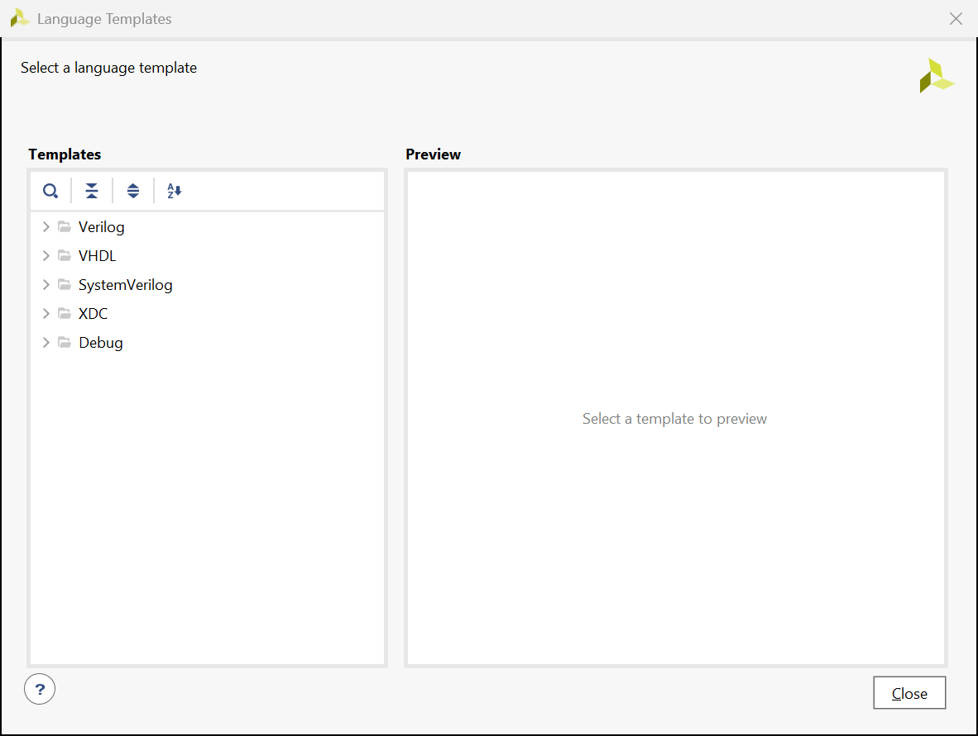
Select verilog

Slide 29
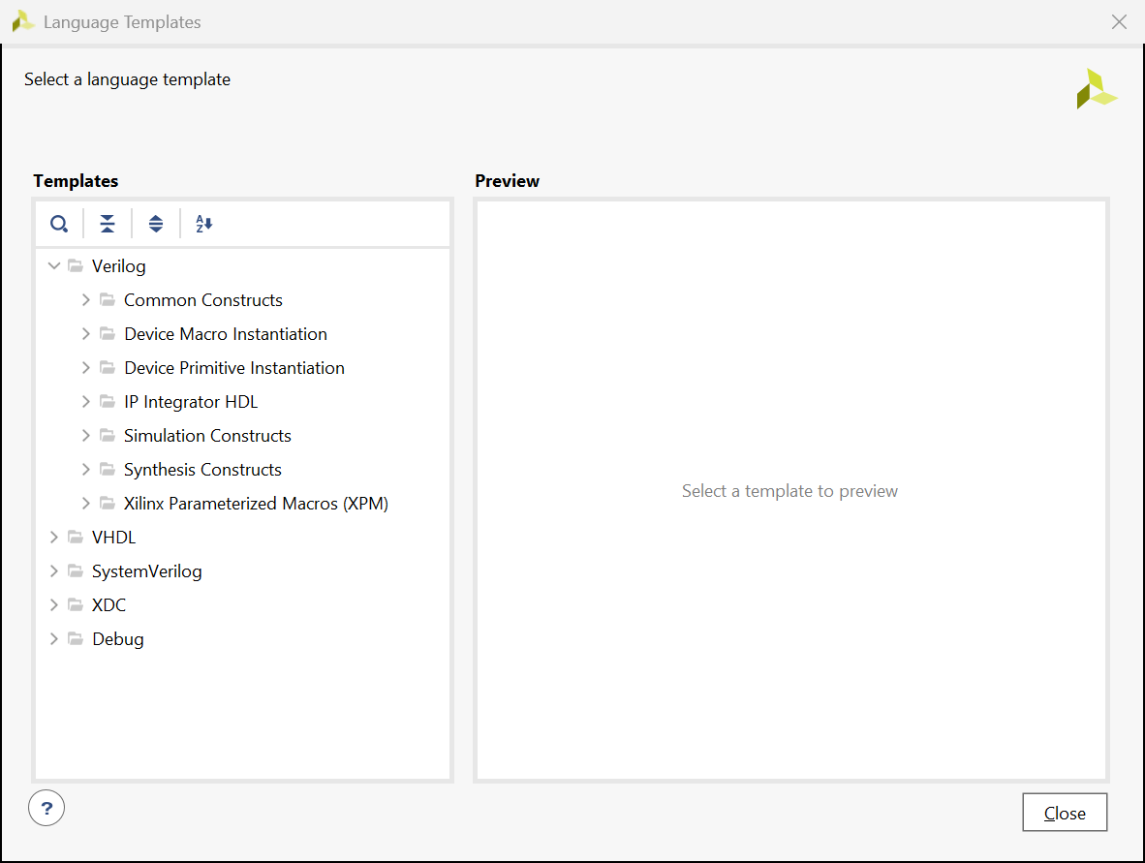


Select device macro instantiation or search ram

Slide 30
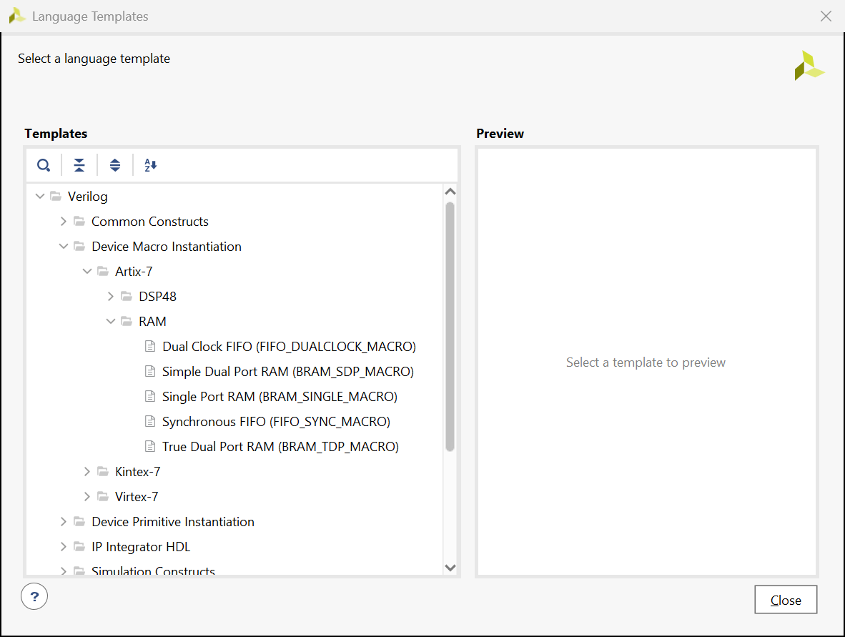










ARTIX -7 -> RAM -> true dual port
Also called HDL instantiation method

Slide 31
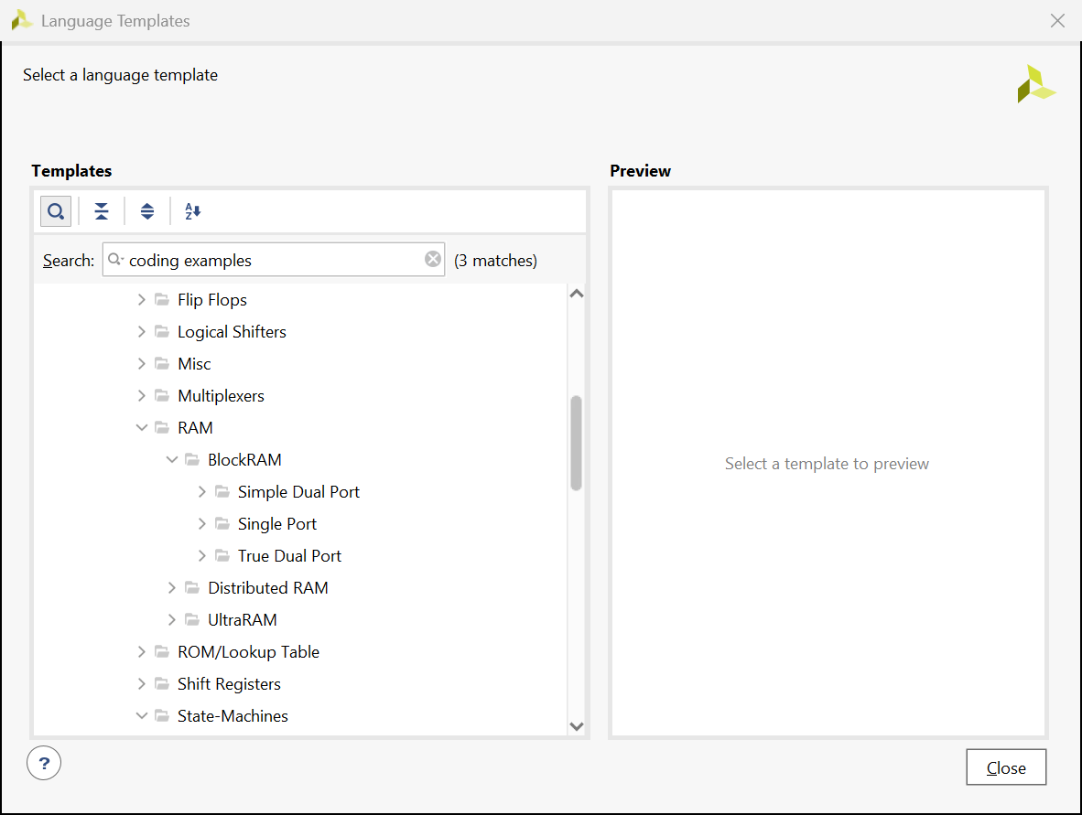


Coding examples -> RAM -> block ram

Slide 32
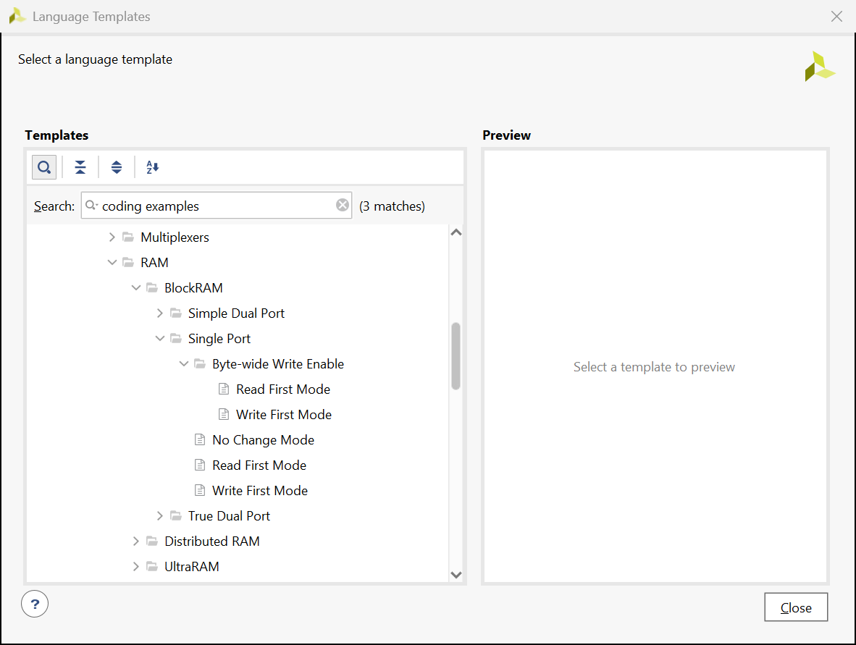



Single port -> write first

Slide 33
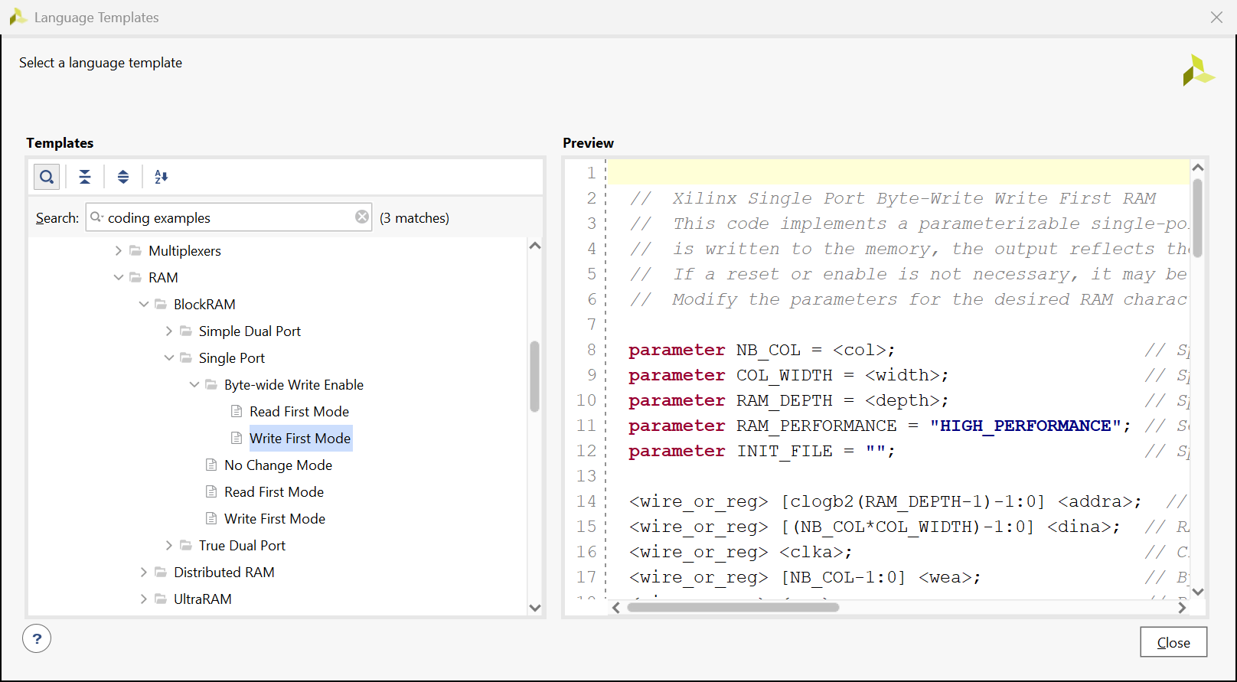








You get a template that you need to follow

Slide 34
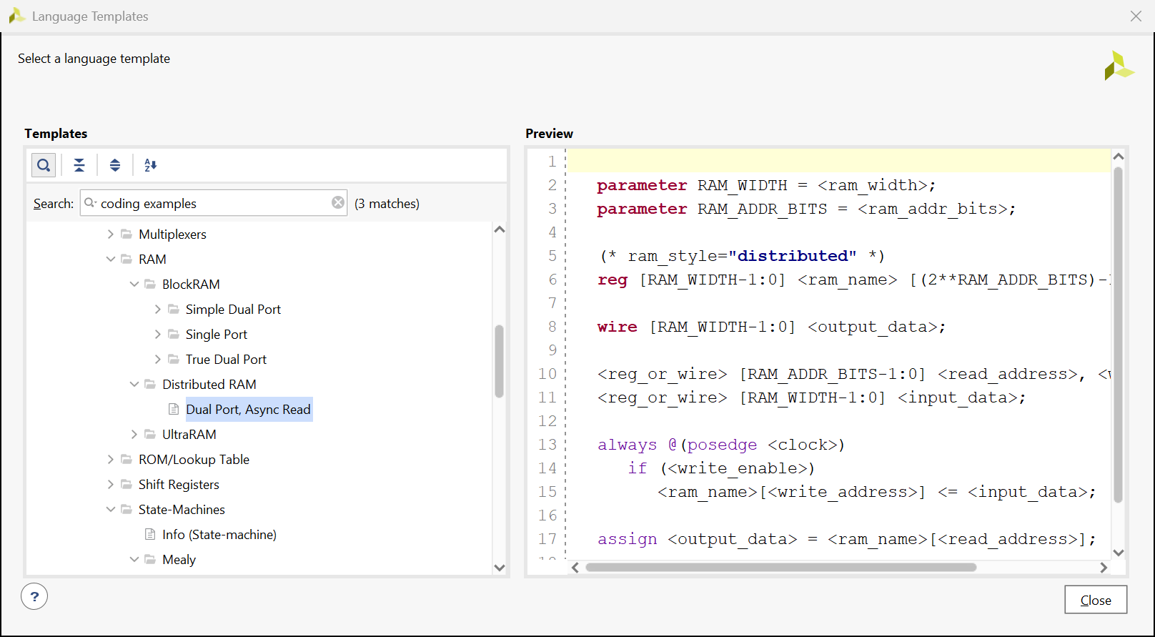






DRAM -> dual port asyn read

Slide 35
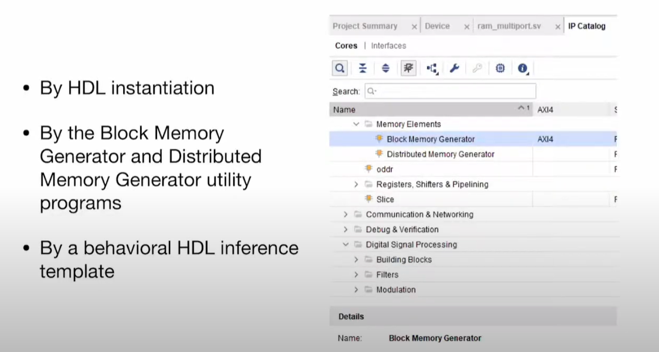


SINGLR PORT RAM – IP METHOD

Slide 36
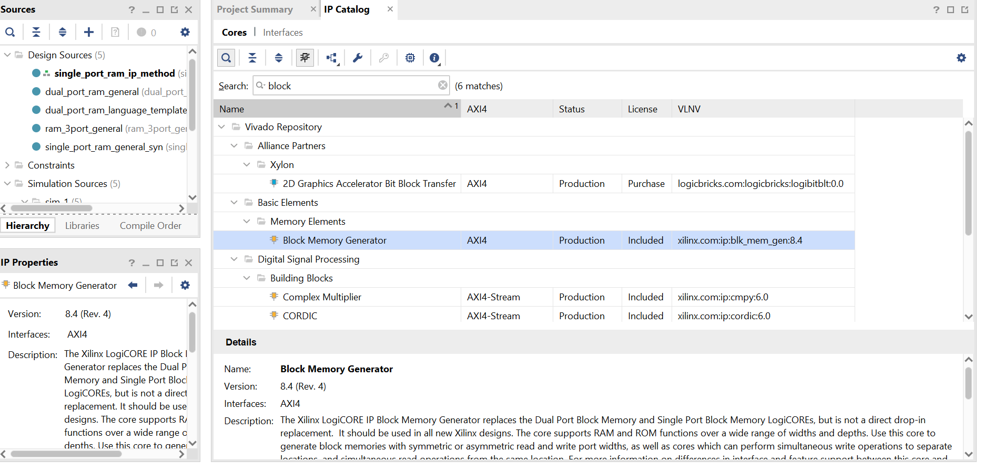


Search block -> click on block memory generator

Slide 37
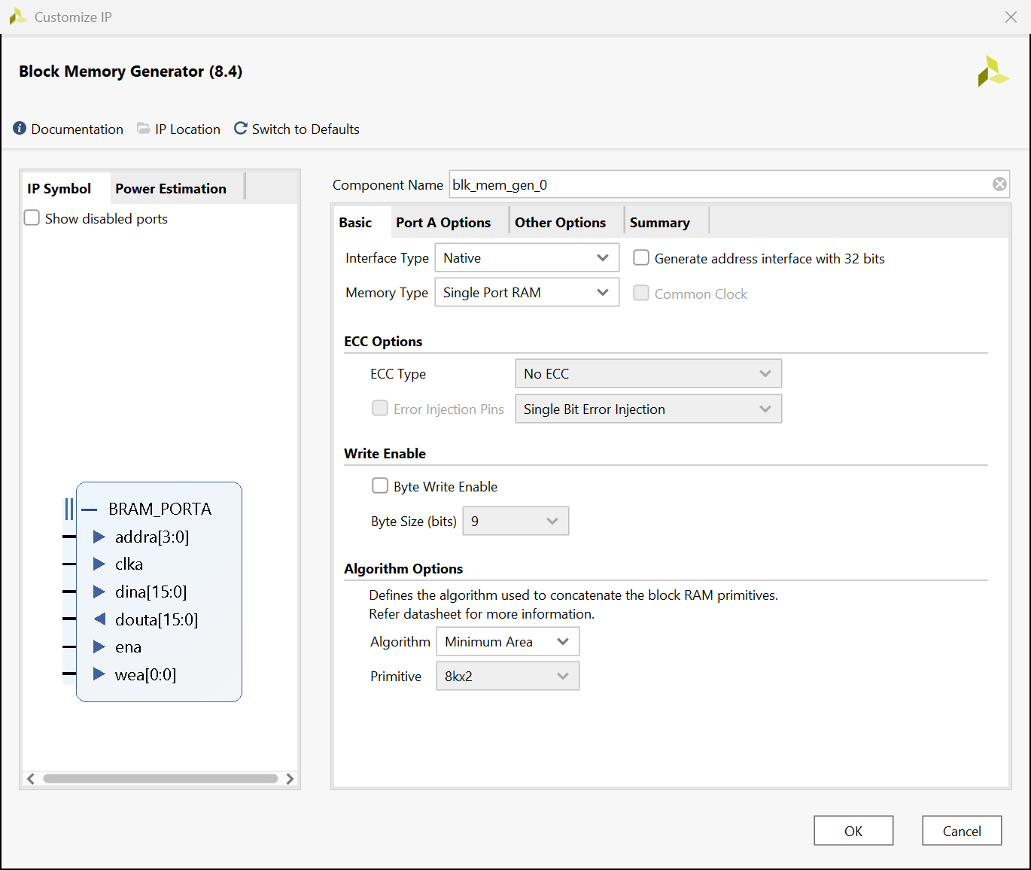
Fill as follows

Slide 38
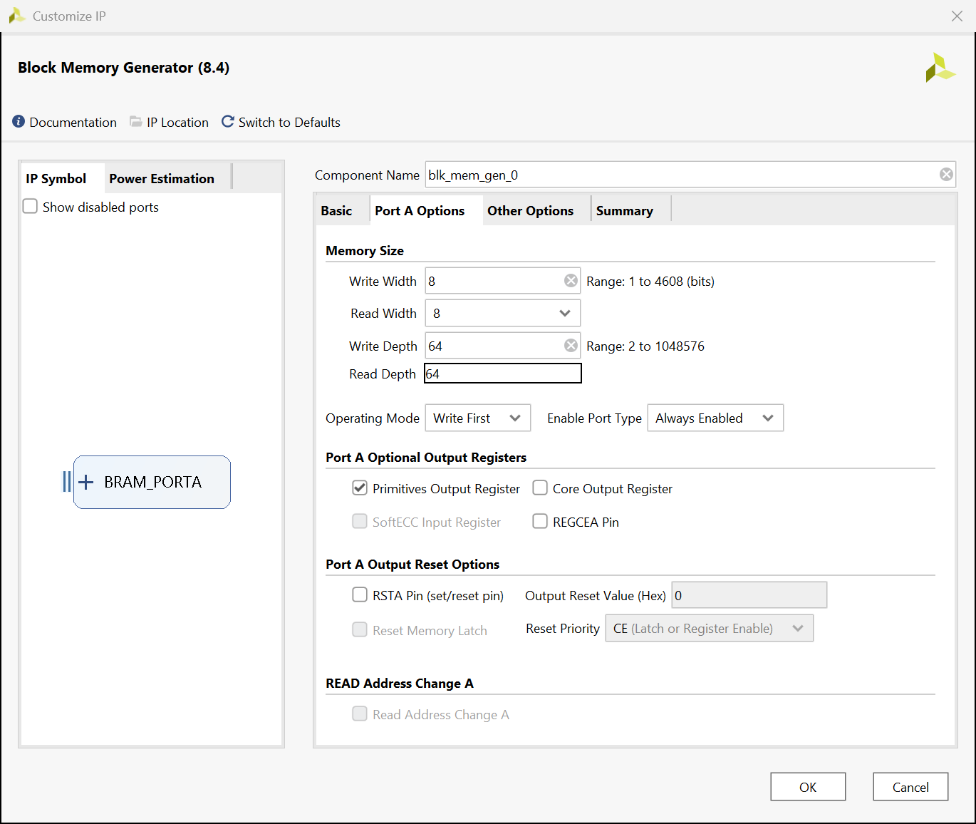
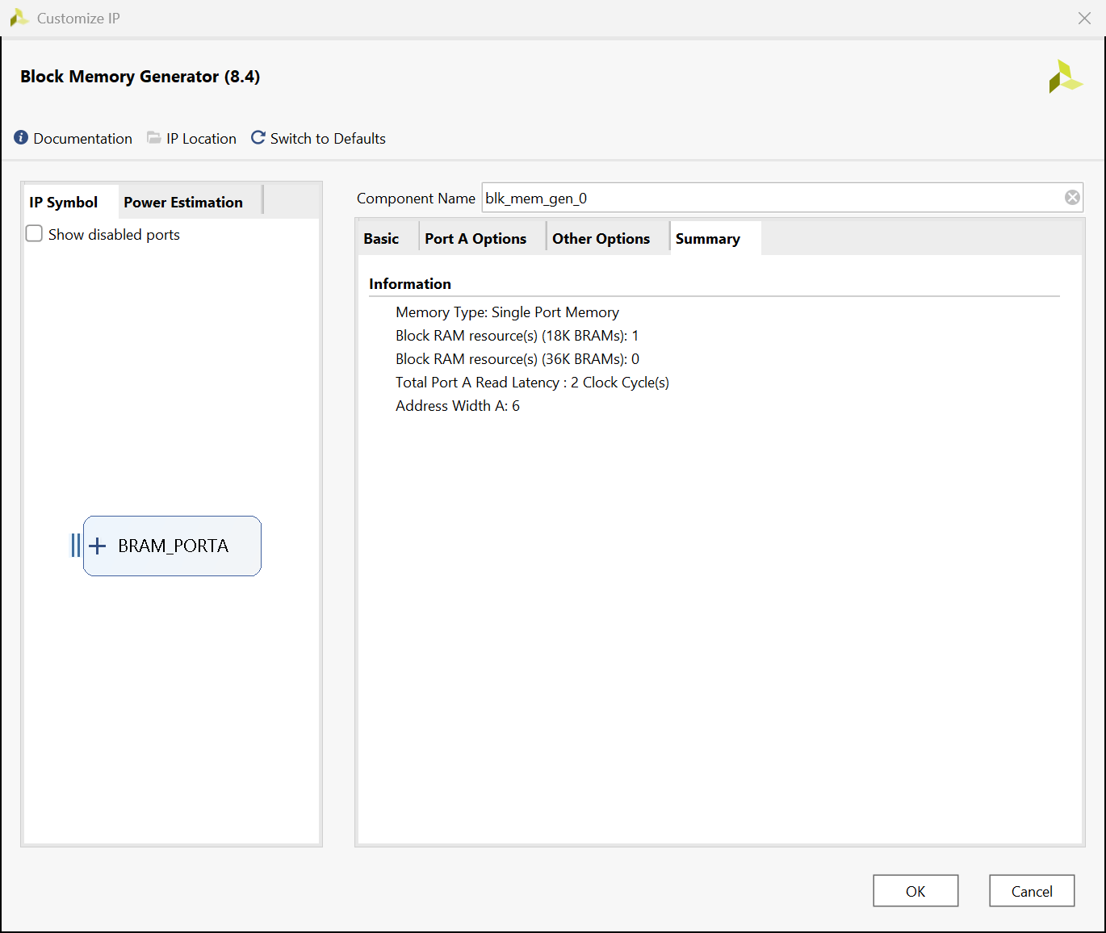
Fill as shown -> click ok

Slide 39
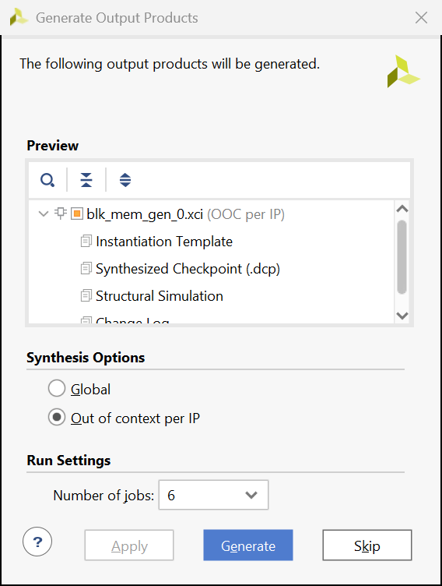
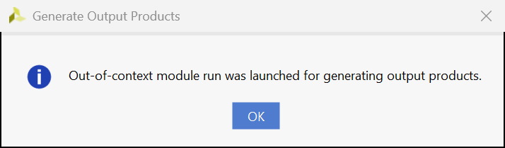
Click on generate -> then ok

Slide 40
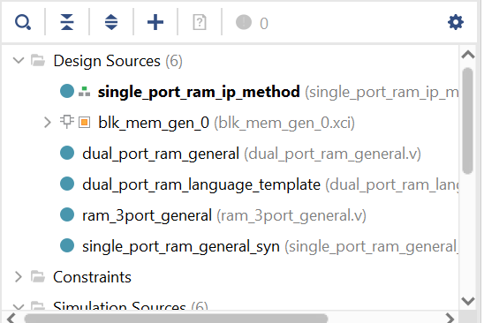
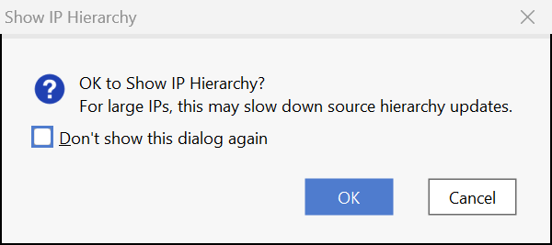
Click on arrow -> then ok

Slide 41
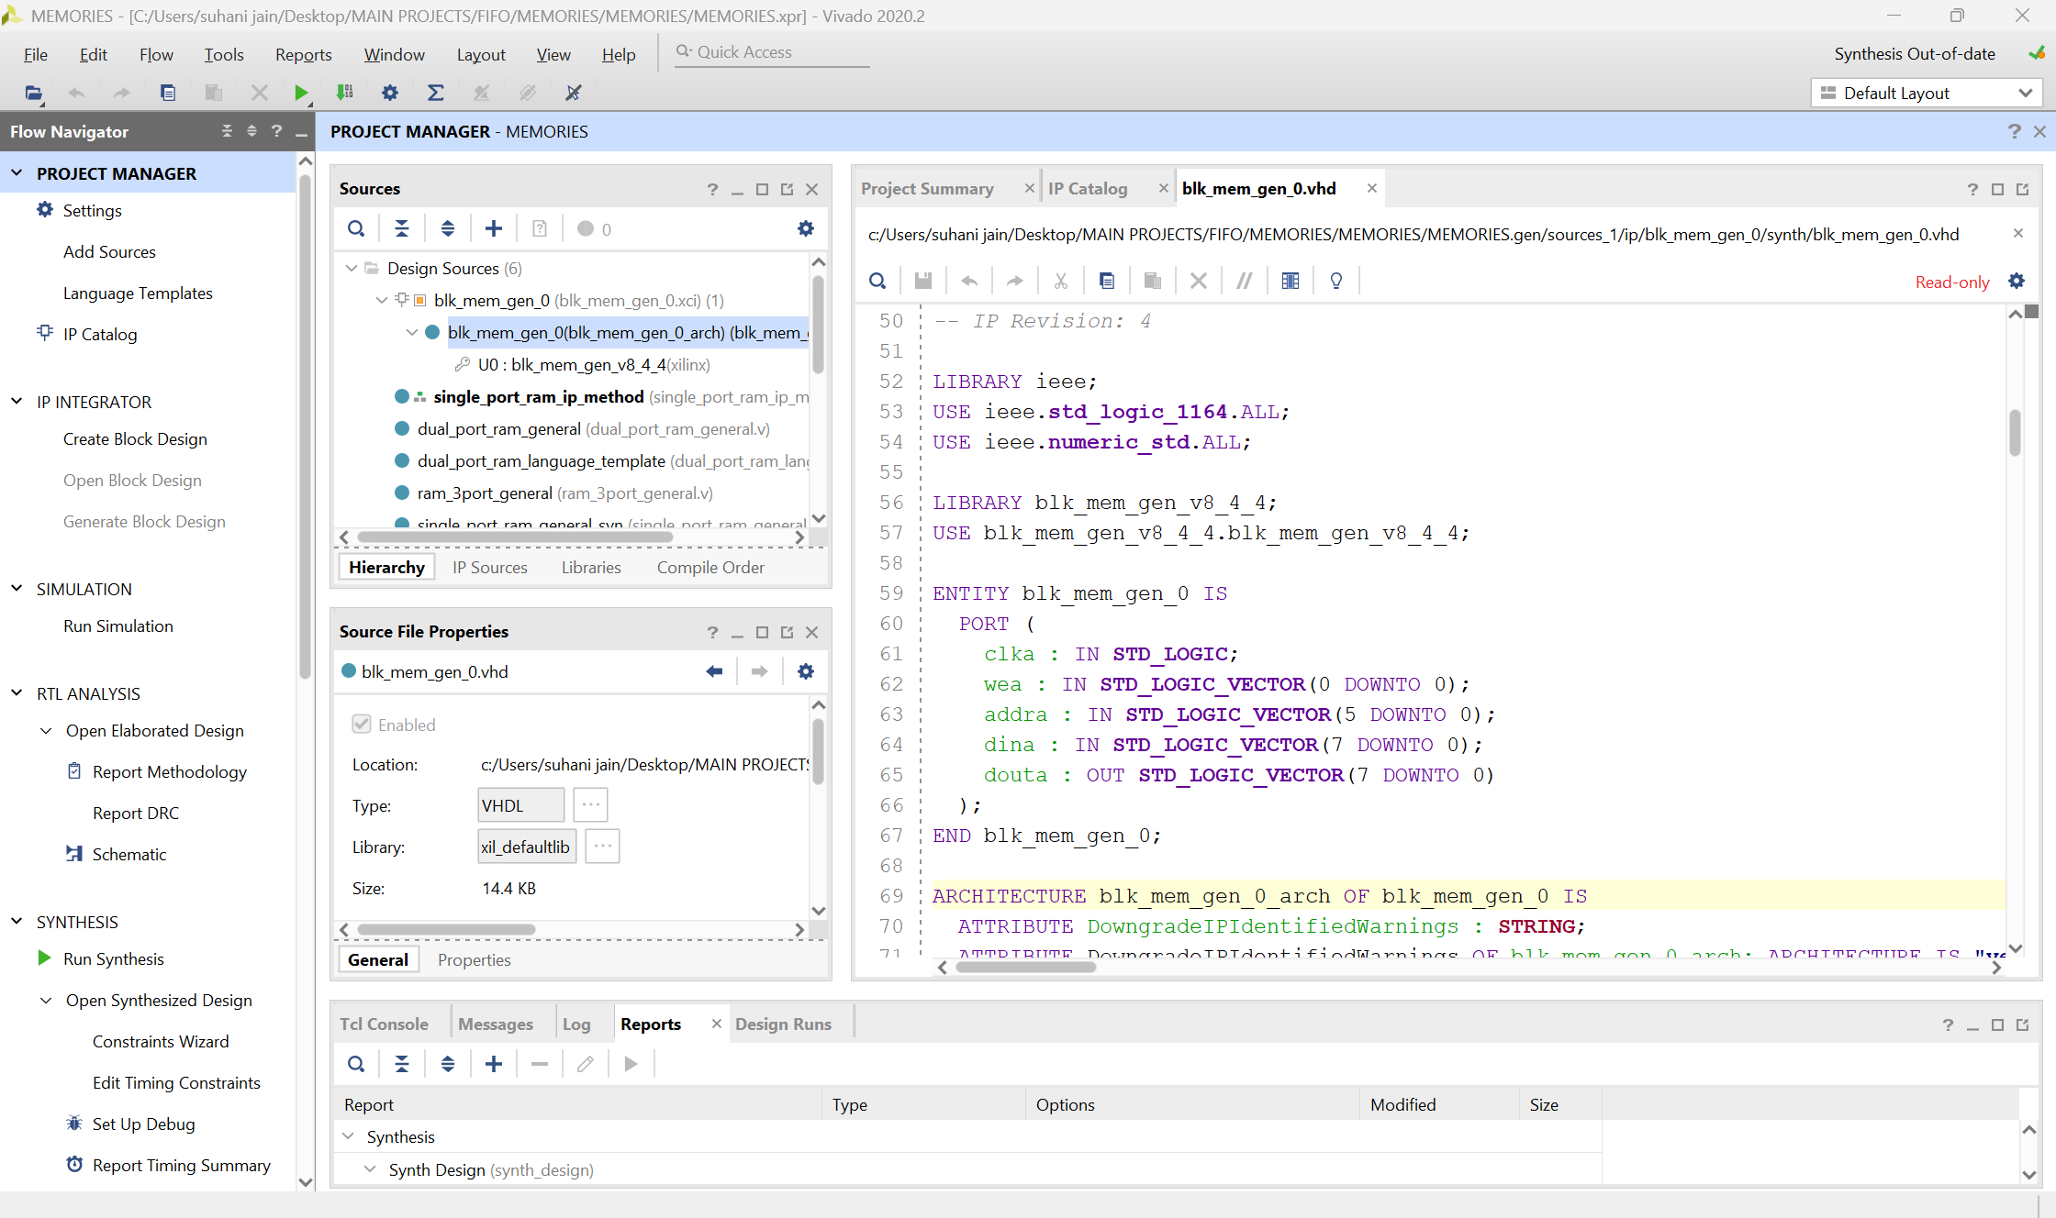








You get a template

Slide 42
CODE
module single_port_ram_ip_method
(
input clk,
input we,
//input rst,
input [5:0] addr, // 2^6
input [7:0] din, // 8 bits
output [7:0] dout
);
blk_mem_gen_0 b1 (clk,we,addr,din,dout);
endmodule

Slide 43
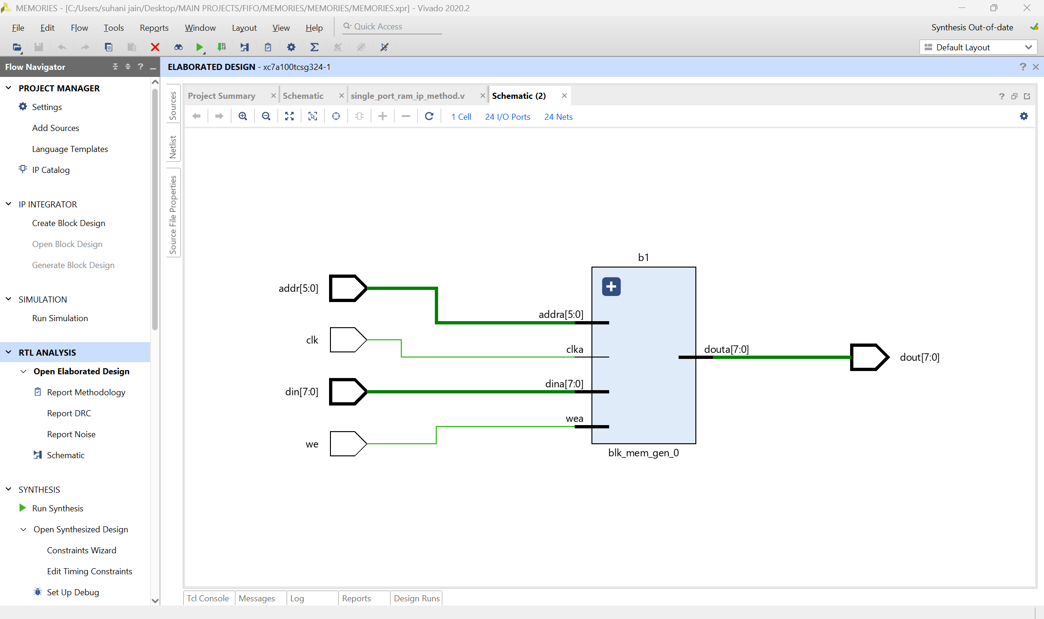
RTL SCHEMATIC

Slide 44
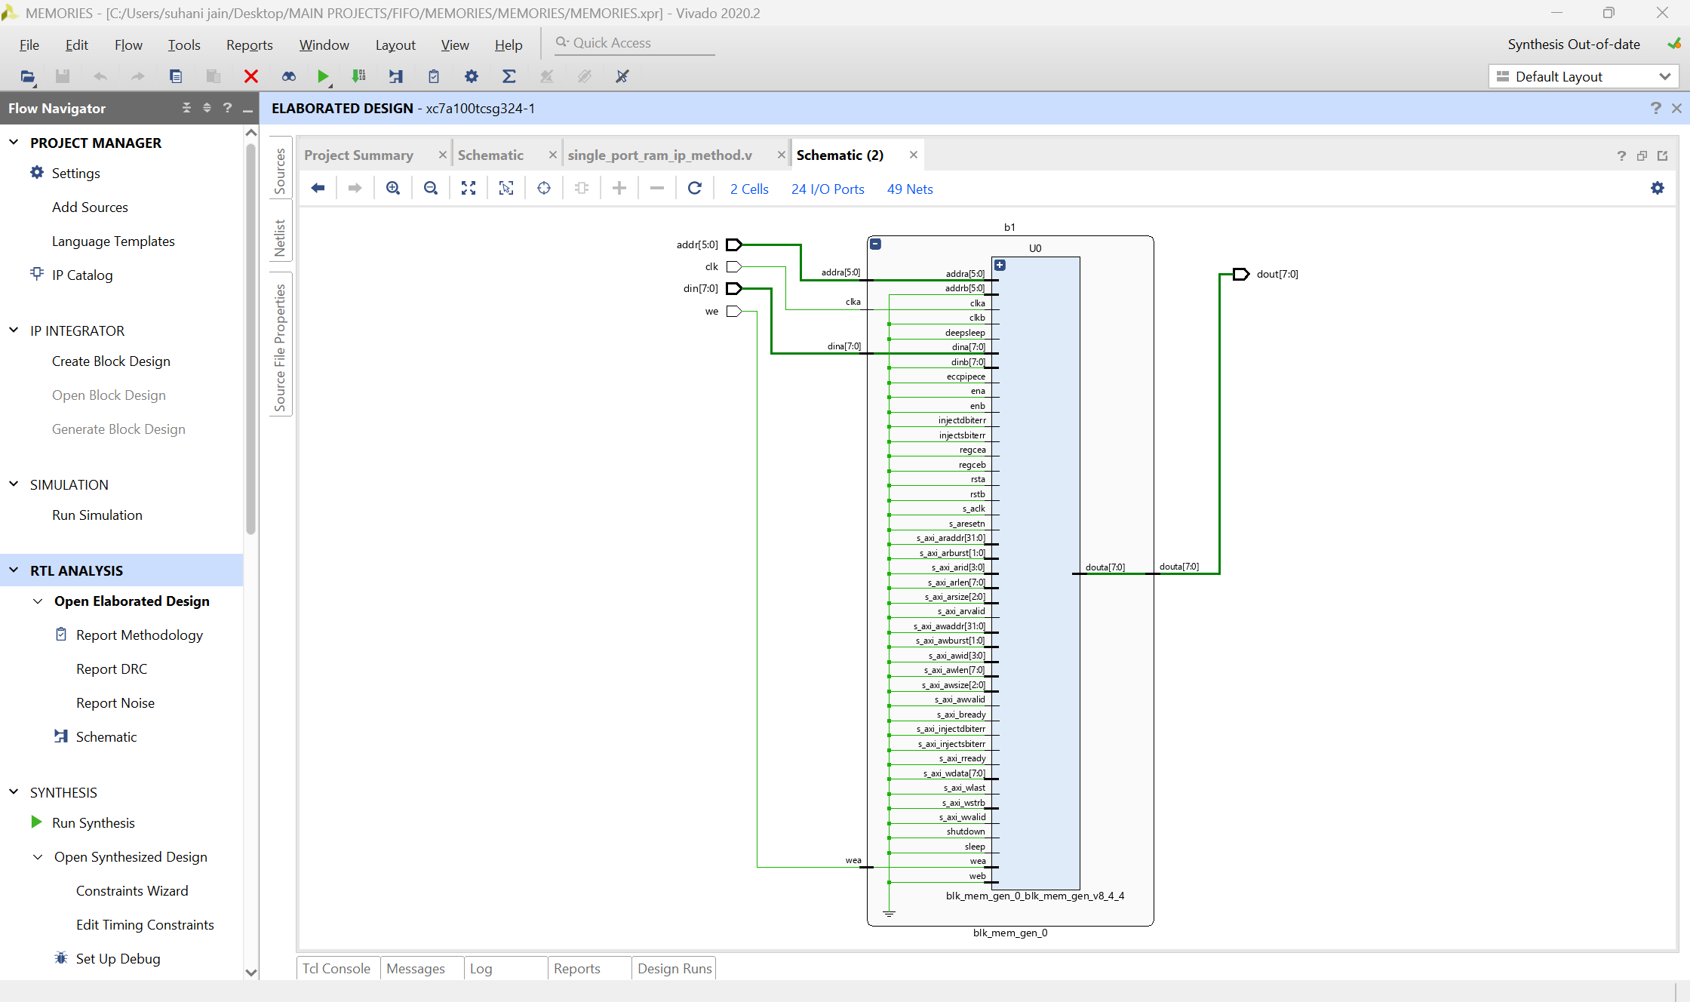

Slide 45
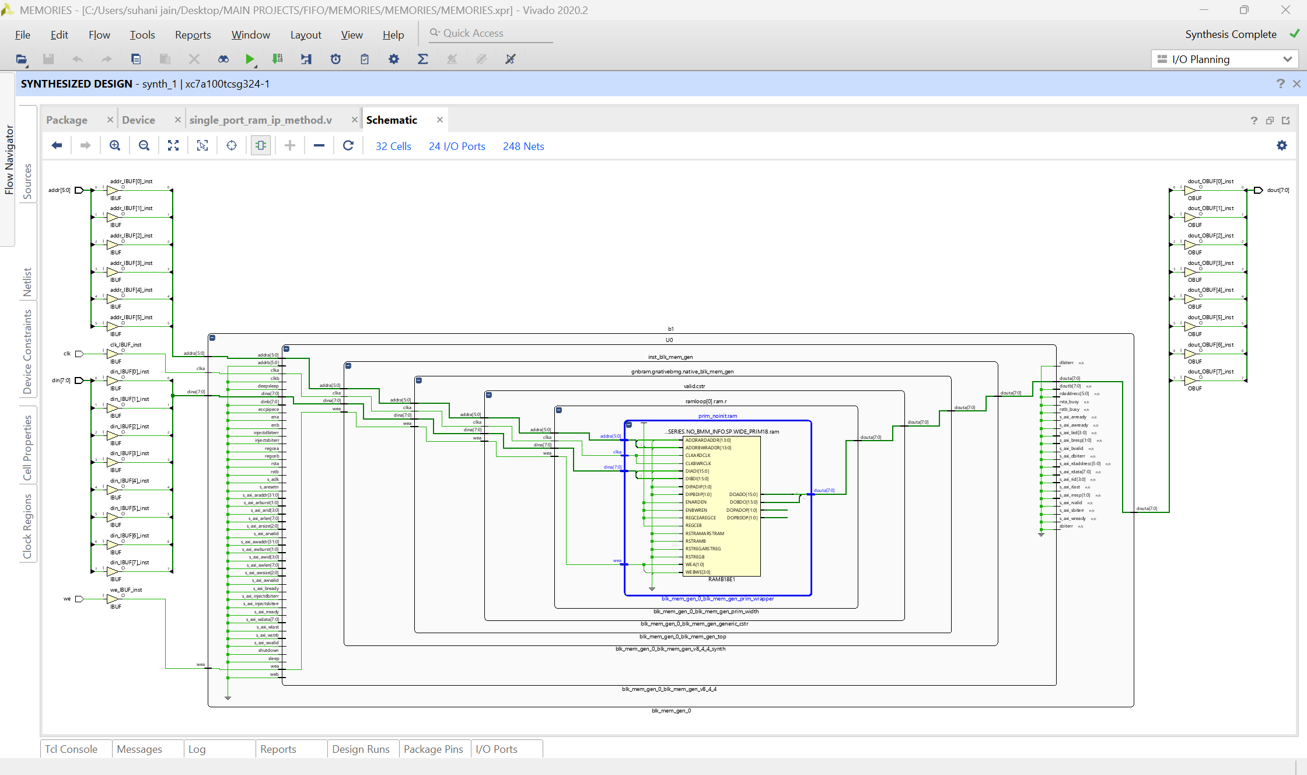



Slide 46
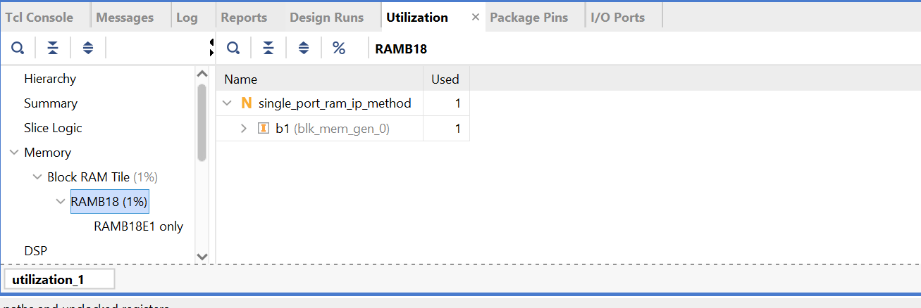

UTILIZATION

Slide 47


DUAL PORT RAM – general method 1 asyn read/ 1 syn write
ALLOWS US TO PERFORM BOTH READ AND WRITE OPERATION AT THE SAME TIME FROM 2 DIFFERENT ADDRESSES

Slide 48
CODE
// mem = 2^3 * 8 = 8*8 memory
module dual_port_ram_general
# (parameter ADDR_WIDTH = 3, DATA_WIDTH=8)
(
input clk, we,
input [DATA_WIDTH-1:0] w_data, // writing data
input [ADDR_WIDTH-1:0] r_addr, w_addr, // reading & writing address
output [DATA_WIDTH-1:0] r_data // reading data
);
// declaring memory size
reg [DATA_WIDTH-1:0] ram2 [0 : 2**ADDR_WIDTH-1];
// syn write operation
always@(posedge clk) begin
if(we)
ram2[w_addr] <= w_data;
end
// asyn read operation // therefore, outside always
assign r_data = ram2[r_addr];
endmodule

Slide 49
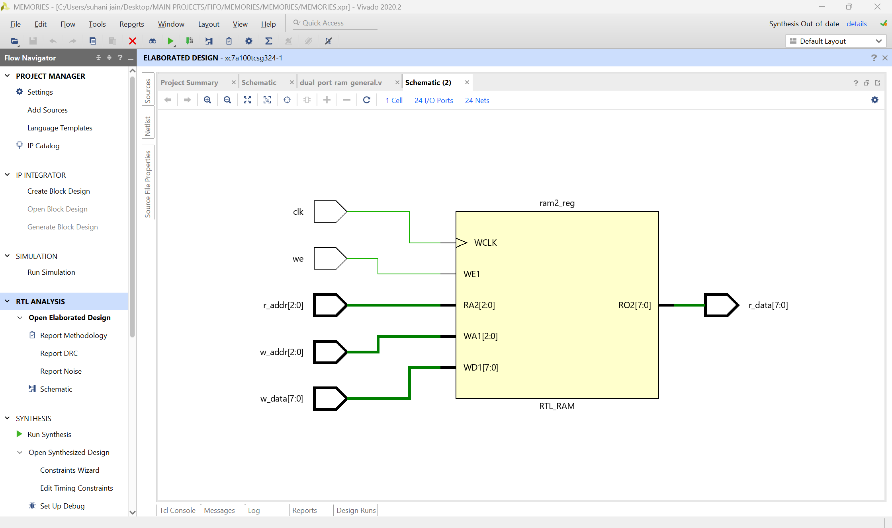
RTL SCHEMATIC

Slide 50
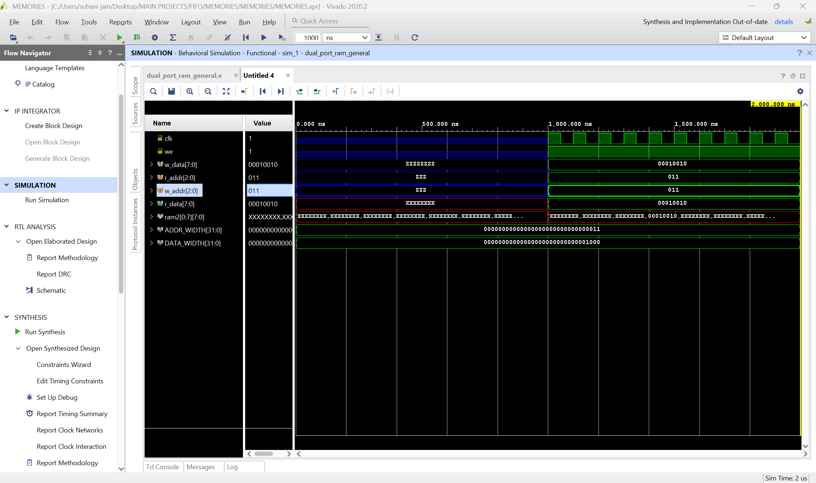

Slide 51
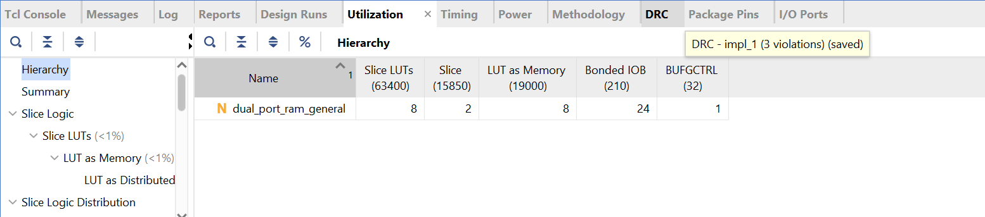
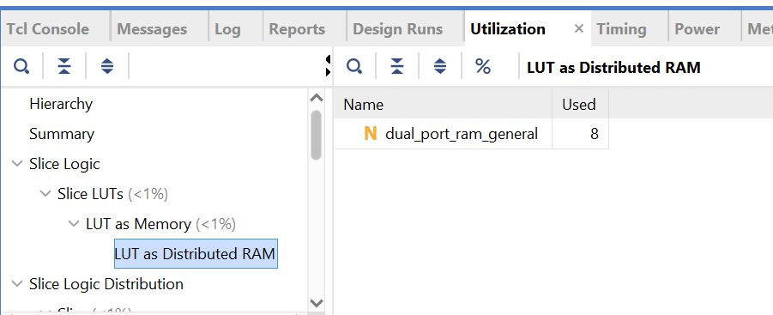
UTILIZATION REPORT – USING DRAM

Slide 52


3 PORT RAM 2 asyn read / 1 syn write

Slide 53
CODE
module ram_3port_general
# (parameter ADDR_WIDTH = 3, DATA_WIDTH=8)
(
input clk, we,
input [DATA_WIDTH-1:0] w_data, // writing data
input [ADDR_WIDTH-1:0] r_addr0,r_addr1, w_addr, // reading & writing address
output [DATA_WIDTH-1:0] r_data0, r_data1 // reading data
);
// declaring memory size
reg [DATA_WIDTH-1:0] ram2 [0 : 2**ADDR_WIDTH-1];
// syn write operation
always@(posedge clk) begin
if(we)
ram2[w_addr] <= w_data;
// r_data1 = ram2[r_addr1]; // if 1 read is syn
end
// asyn read operation // therefore, outside always
assign r_data0 = ram2[r_addr0];
assign r_data1 = ram2[r_addr1];
endmodule

Slide 54
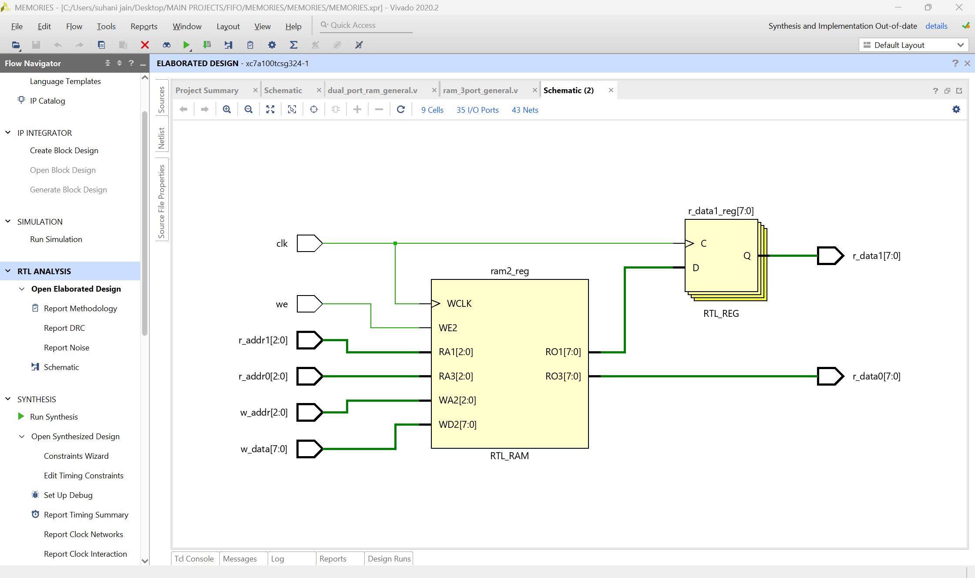
1 read is syn

Slide 55
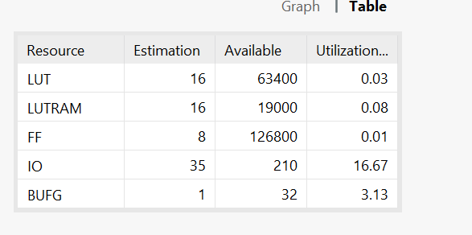
SYNTHESIS SUMMARY

Slide 56
DUAL PORT RAM – LANGUAGE TEMPLATE (cont)
// TEMPLATE
parameter RAM_WIDTH = <ram_width>;
parameter RAM_ADDR_BITS = <ram_addr_bits>;
(* ram_style="distributed" *)
reg [RAM_WIDTH-1:0] <ram_name> [(2**RAM_ADDR_BITS)-1:0];
wire [RAM_WIDTH-1:0] <output_data>;
<reg_or_wire> [RAM_ADDR_BITS-1:0] <read_address>, <write_address>;
<reg_or_wire> [RAM_WIDTH-1:0] <input_data>;
always @(posedge <clock>)
if (<write_enable>)
<ram_name>[<write_address>] <= <input_data>;
assign <output_data> = <ram_name>[<read_address>];

Slide 57
CODE – FOLLOWING THE TEMPLATE
module dual_port_ram_language_template
# (parameter ADDR_WIDTH = 3, DATA_WIDTH=8)
(
input clk, we,
input [DATA_WIDTH-1:0] w_data, // writing data
input [ADDR_WIDTH-1:0] r_addr, w_addr, // reading & writing address
output [DATA_WIDTH-1:0] r_data // reading data
);
// declaring memory size
reg [DATA_WIDTH-1:0] ram2 [(2**ADDR_WIDTH-1) : 0];
// following the template
always @(posedge clk)
if(we)
ram2[w_addr] <= w_data;
assign r_data = ram2[r_addr];
endmodule

Slide 58
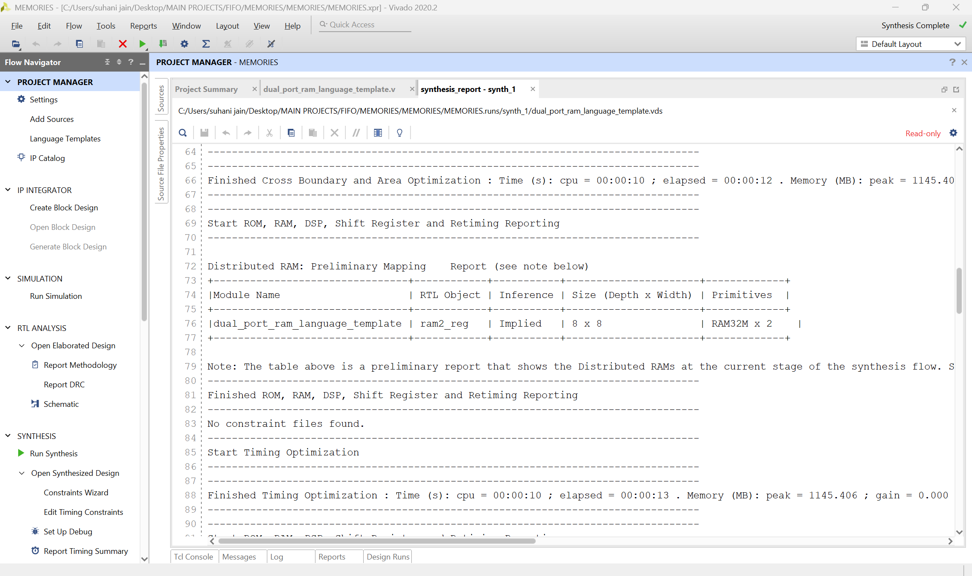
SYNTHESIS REPORT

Slide 59
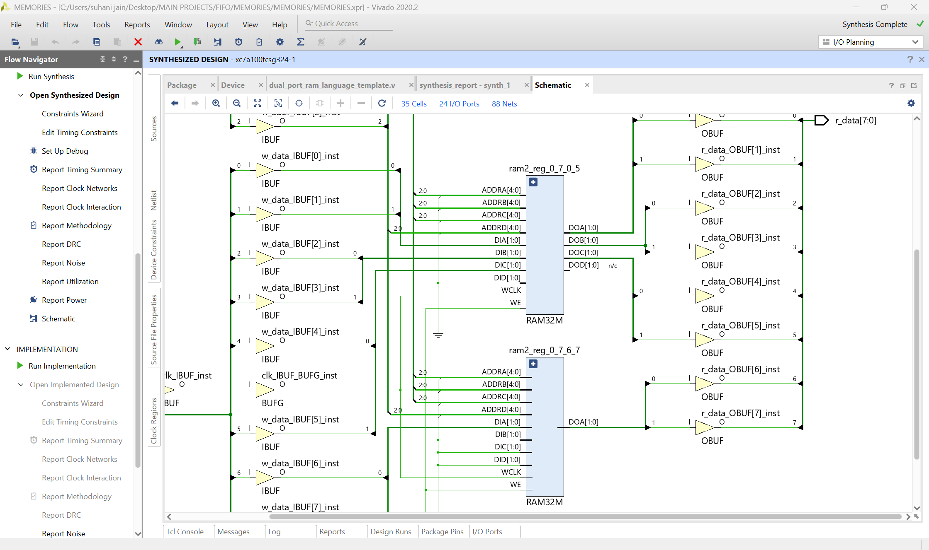
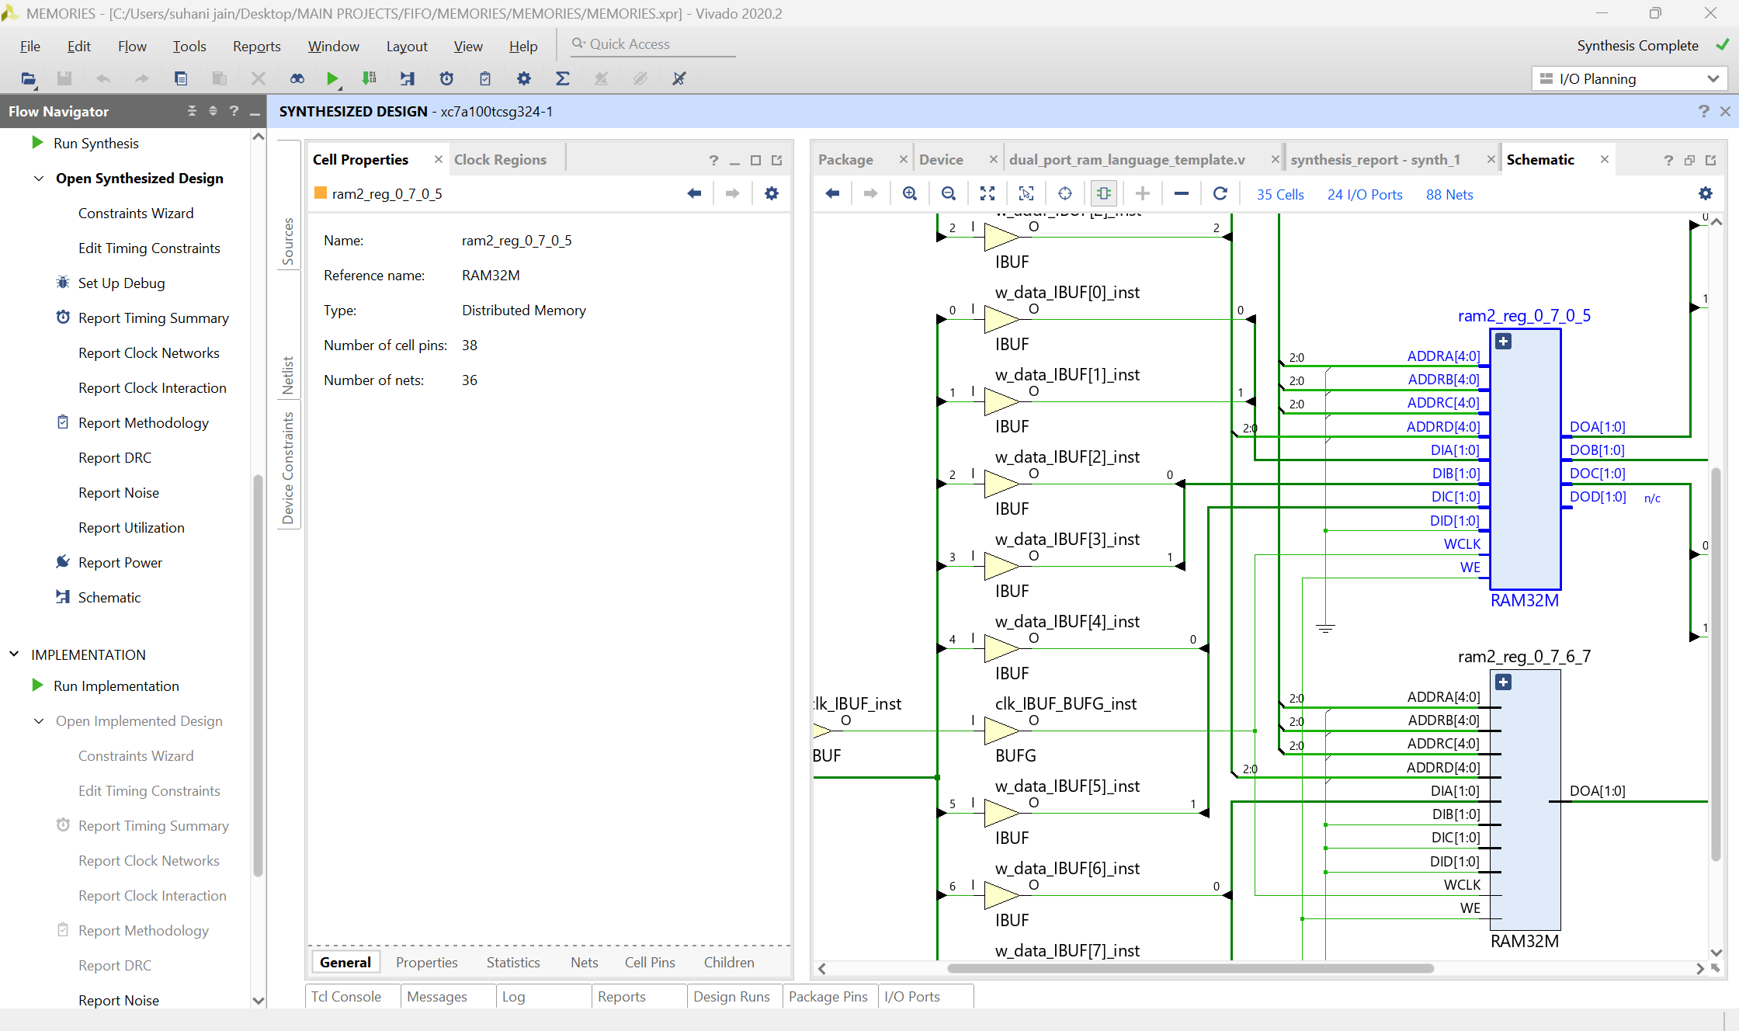




SCHEMATIC- SYNTHESIS

Slide 60
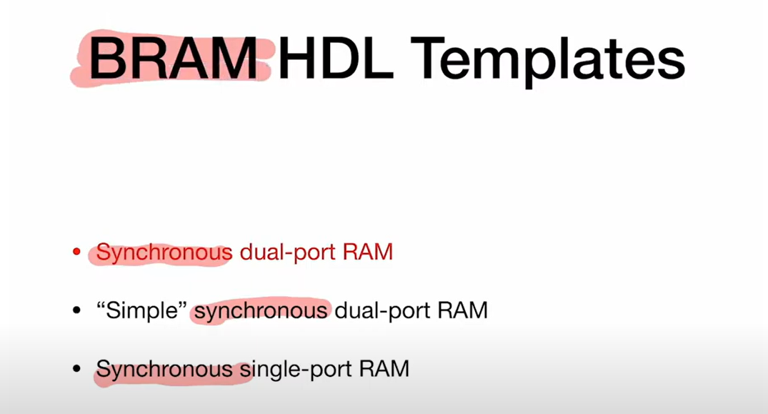
ANOTHER METHOD BRAM TEMPLATE BY BEHAVIORAL HDL

Slide 61
1. SYN DUAL PORT RAM

Slide 62
CODE
module bram_syn_dual_port
# (parameter ADDR_WIDTH = 10, DATA_WIDTH=8)
(
input clk, we_a,we_b,
input [DATA_WIDTH-1:0] din_a,din_b, // writing data
input [ADDR_WIDTH-1:0] addr_a, addr_b, // reading & writing address
output reg [DATA_WIDTH-1:0] dout_a,dout_b // reading data
);
// declaring memory size
reg [DATA_WIDTH-1:0] ram2 [0 : 2**ADDR_WIDTH-1];
// port a
always@(posedge clk) begin
if(we_a)
ram2[addr_a] <= din_a;
dout_a <= ram2[addr_a];
end
// port b
always@(posedge clk) begin
if(we_b)
ram2[addr_b] <= din_b;
dout_b <= ram2[addr_b];
end
endmodule

Slide 63
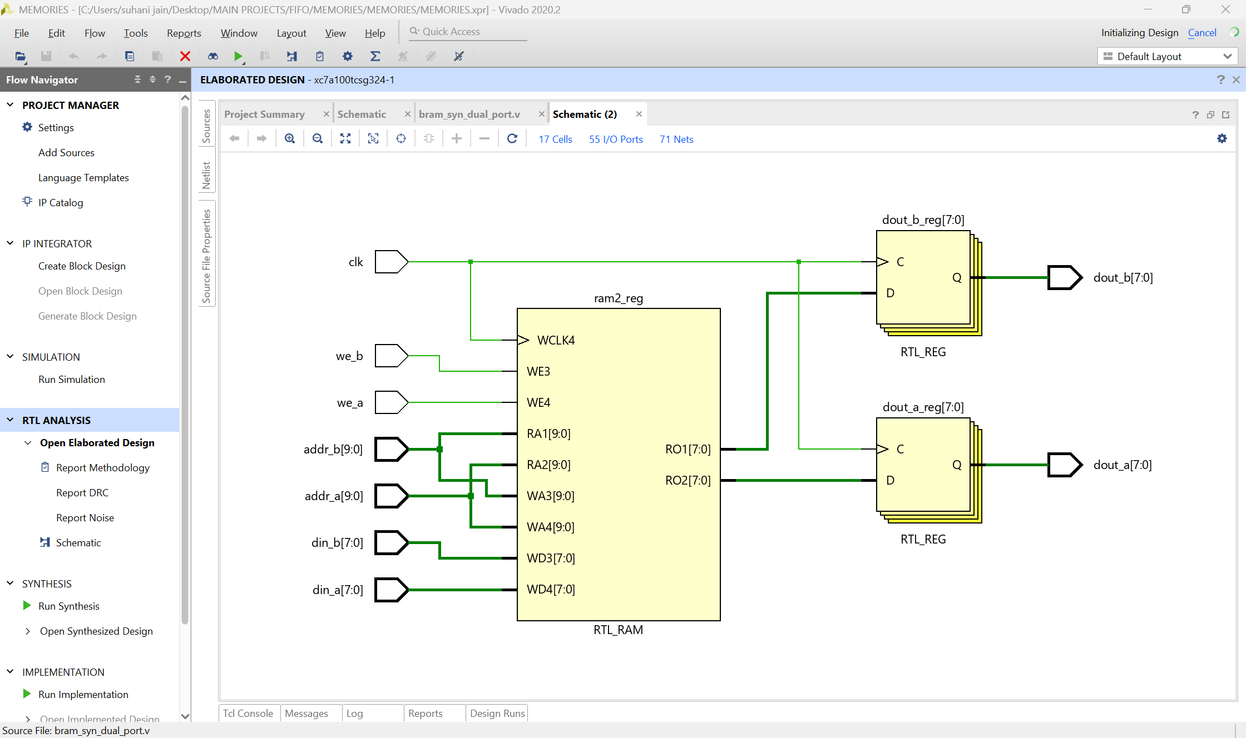
RTL ANALYSIS

Slide 64
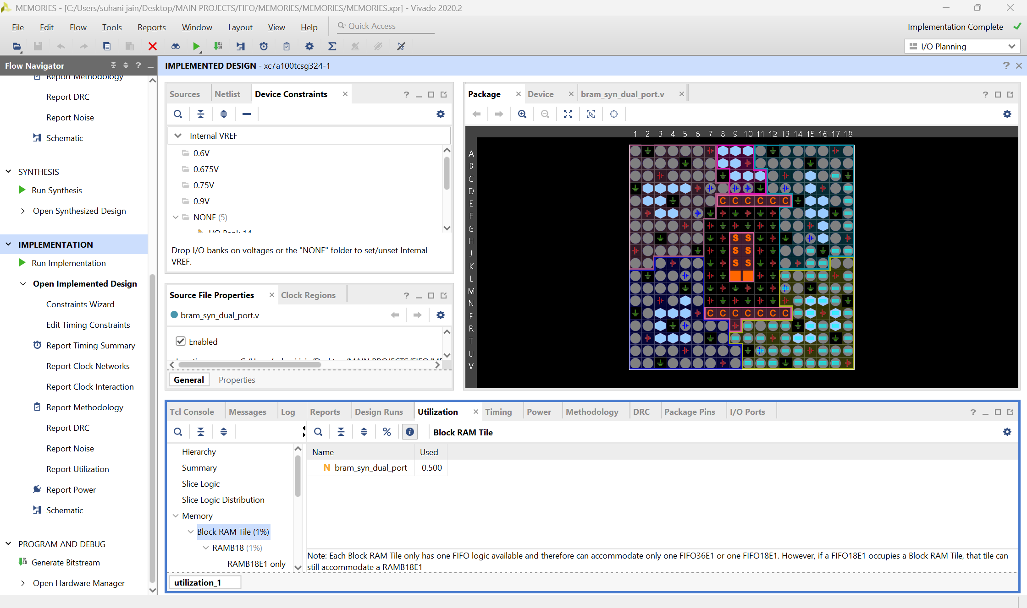


UTILIZATION

Slide 65

SIMPLE SYN DUAL PORT RAM

Slide 66
CODE
module simple_bram_syn_dual_port_ram
# (parameter ADDR_WIDTH = 10, DATA_WIDTH=8)
(
input clk, we_a,
input [DATA_WIDTH-1:0] din, // writing data
input [ADDR_WIDTH-1:0] addr_w,addr_r, // reading & writing address
output reg [DATA_WIDTH-1:0] dout // reading data
);
// declaring memory size
reg [DATA_WIDTH-1:0] ram2 [0 : 2**ADDR_WIDTH-1];
// port a
always@(posedge clk) begin
if(we_a)
ram2[addr_w] <= din;
dout <= ram2[addr_r];
end
endmodule

Slide 67

BRAM SINGLE PORT RAM

Slide 68
CODE
module bram_single_port_ram
# (parameter ADDR_WIDTH = 10, DATA_WIDTH=8)
(
input clk, we_a,
input [DATA_WIDTH-1:0] din_a, // writing data
input [ADDR_WIDTH-1:0] addr_a, // reading & writing address
output reg [DATA_WIDTH-1:0] dout_a // reading data
);
// declaring memory size
reg [DATA_WIDTH-1:0] ram2 [0 : 2**ADDR_WIDTH-1];
// port a
always@(posedge clk) begin
if(we_a)
ram2[addr_a] <= din_a;
else
dout_a <= ram2[addr_a];
end
endmodule

